Slide 1
RUNGTA COLLEGE OF DENTAL SCIENCES & RESEARCH
TITLE OF THE TOPIC-
SKELETAL MATURITY INDICATORS
DEPARTMENT OF ORTHODONTICS AND DENTOFACIAL ORTHOPAEDICS

Slide 2
Specific learning Objectives
CORE AREAS | DOMAIN | CATEGORY
Different methods of growth assesment | COGNITIVE | NICE TO KNOW
Requirement of an ideal maturity indicator | COGNITIVE | DESIRE TO KNOW
Skeletal maturity indicators | PSYCHOMOTOR | NICE TO KNOW
Hand wrist radiograph | PSYCHOMOTOR | MUST KNOW
Cervical vertebrae maturation | PSYCHOMOTOR | MUST KNOW

Slide 3
CONTENTS
Introduction
Different methods of growth assesment
Requirement of an ideal maturity indicator
Skeletal maturity indicators
Hand wrist radiograph
Cervical vertebrae maturation
Conclusion

Slide 4
Introduction
Human growth shows considerable variation in the chronological ages at which individual children reach similar developmental events.
Therefore, an understanding of growth events is of primary importance in the practice of orthodontics.
Biological age, skeletal age, bone age, and skeletal maturations are nearly synonymous terms used to describe the maturation of a person.

Slide 5
Requirement of an ideal maturity indicator
Should be safe and non invasive
Require minimum radiation
Should be accurate
Stage of maturity should be well defined
Easily identifiable
Cost effective
Require minimum armamentarium
Simple to conduct
Valid overtime and across age group

Slide 6
Skeletal age- Skeletal maturation has been used to assess a child’s developmental age. Most commonly the hand wrist bones was found and correlated with development.

Slide 7
SKELETAL MATURITY INDICATORS
Hand wrist radiograph
Cervical vertebrae maturation indicator
different stages of tooth development

Slide 8
HAND WRIST RADIOGRAPH
The hand wrist region is made of numerous small bones which show predictable and scheduled pattern of appearance, ossification, and union from birth to maturity.
Carpal bones (Lyser in 1683) includes proximal and distal rows
Proximal row: navicular, lunate, triquetral, pisiform.
Distal row: greater and lesser multiangular, capitate, hamate.

Slide 9
Indications for hand & wrist radiographs
Prior to rapid maxillary expansion
When maxilla-mandibular changes are indicated
Marked discrepancy b/w chronologic and dental age
Orthodontic patients requiring orthognathic surgery between 16 & 20 yrs of age.
Determination of skeletal maturity status prior to treatment of skeletal malocclusion such as a skeletal class II or class III malocclusion.
To predict the pubertal growth spurt.

Slide 10
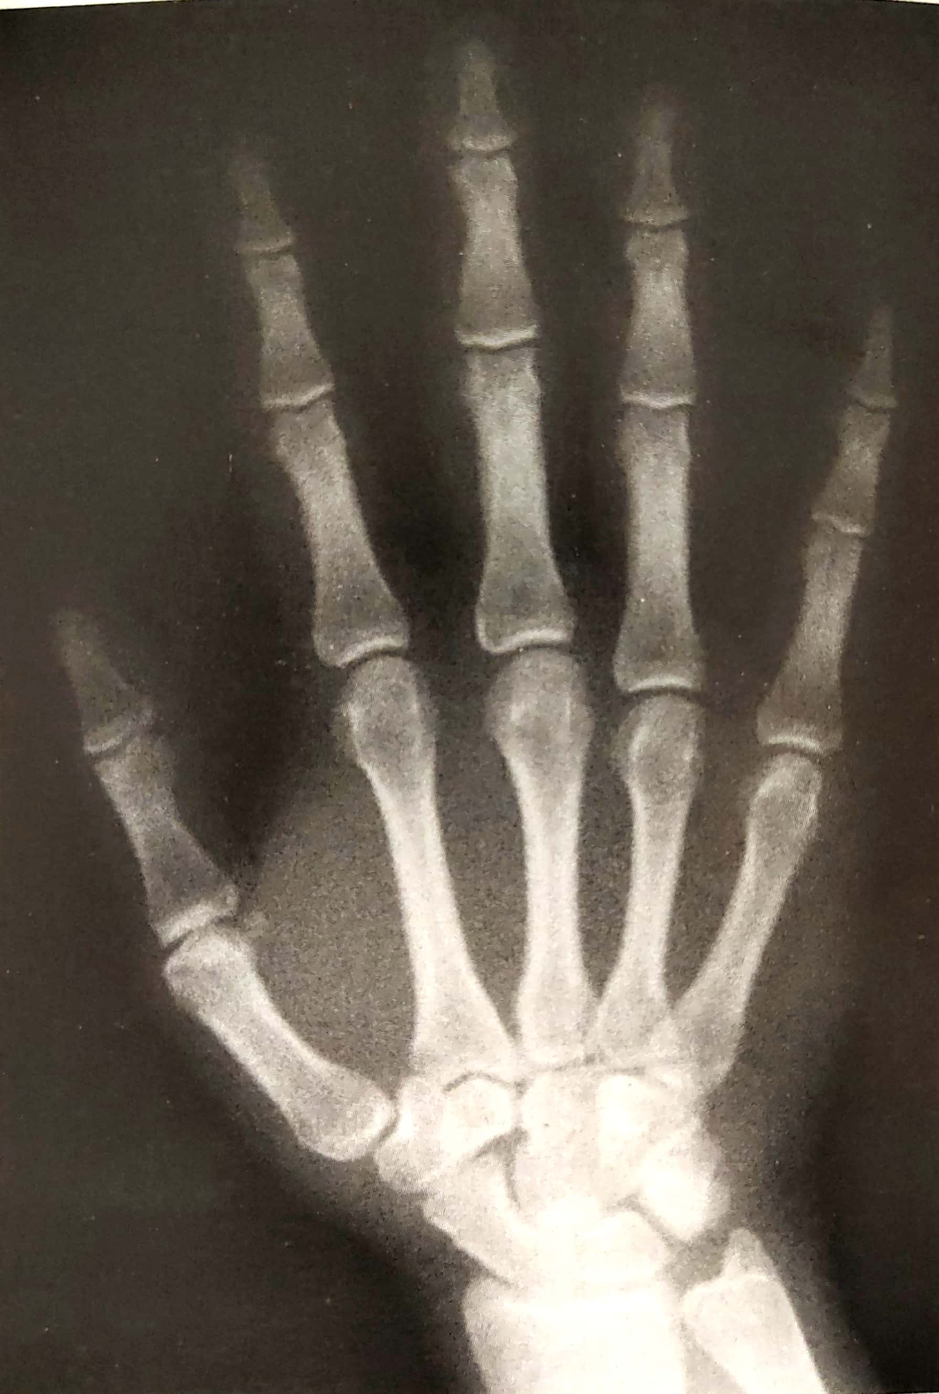
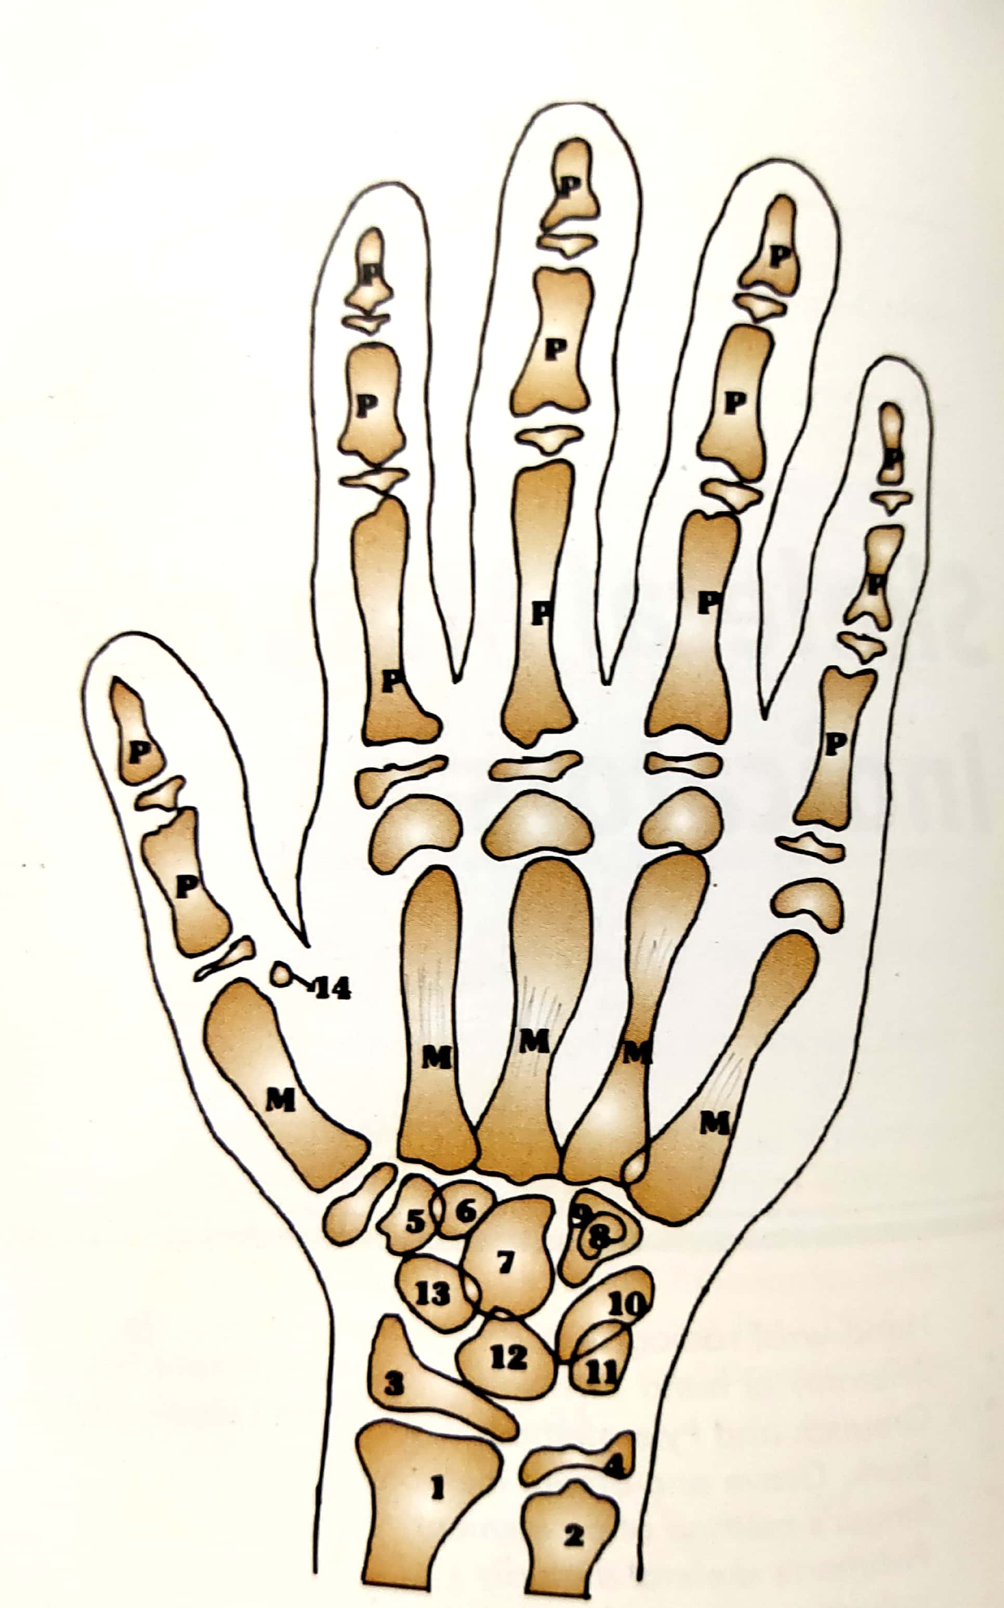
ANATOMY OF THE HAND WRIST
1:Radius
Ulna
Distal epiphysis of radius
Distal epiphysis of ulna
Trapezium
Trapezoid
Capitate
Hamular process of hamate
Hamate
Triquetral
Pisiform
Lunate
Scaphoid
Sesamoid

Slide 11
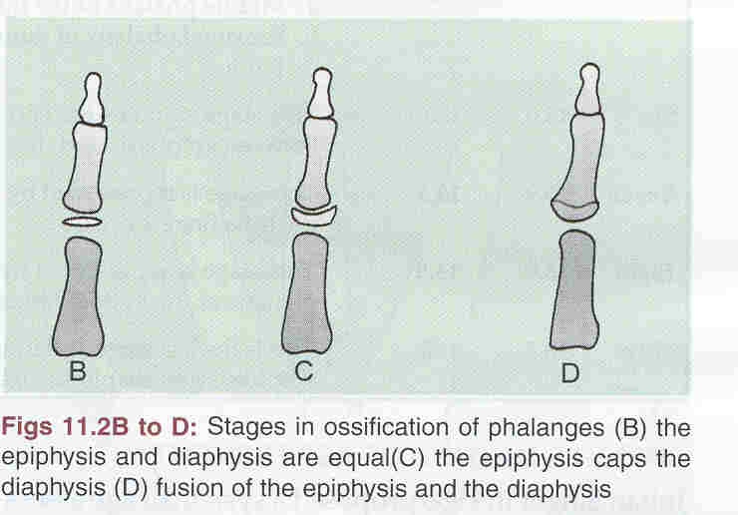
Stages in the ossification of phalanges
Stage one — the width of epiphysis and diaphysis are equal.
Stage two — the epiphysis caps the diaphysis by surrounding it like a cap.
Stage three — fusion occurs between the epiphysis and diaphysis.

Slide 12
Methods used in hand wrist radiograph
1- Atlas method by Greulich and Pyle.
2- Bjork, Grave and Brown method.
3- Fishman’s skeletal maturity indicator.
4- Hagg and Taranger method.

Slide 13
Fishman skeletal maturity assessment
Leonard S Fishman in 1982 developed this method to pridict the skeletal maturation.
It makes use of 6 anatomical site located on thumb, third finger, fifth finger and radius.
11 discrete adolescent maturity indicators covering the entire period of adolescent growth, are found on these sites.

Slide 14
This system of interpretation uses 4 stages of bone maturation-
1- epiphysis equal in width to diaphysis
2- appearance of adductor sesamoid of the thumb
3- capping of epiphysis
4- fusion of epiphysis and diaphysis

Slide 15
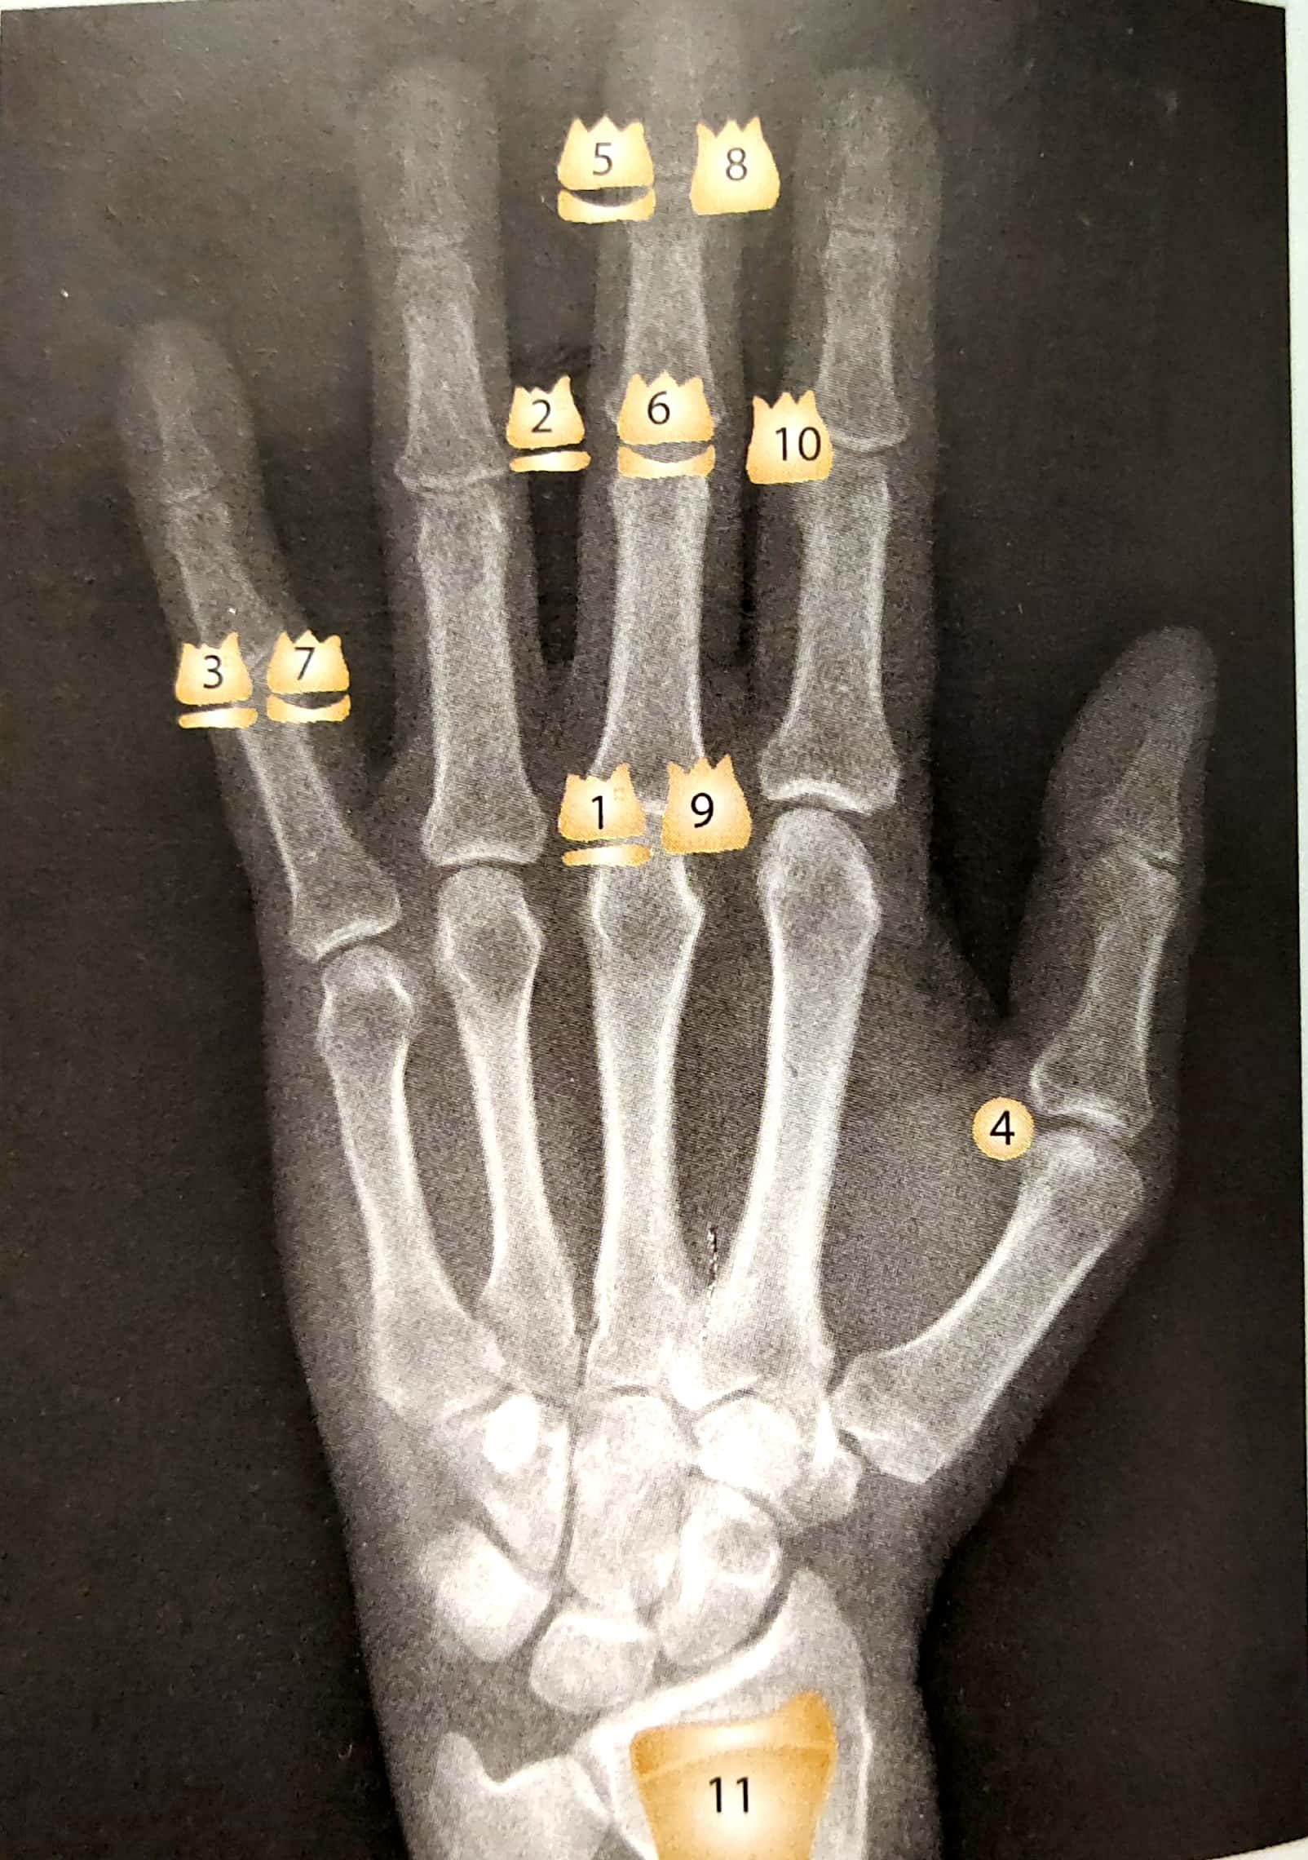
The 11 skeletal maturity indicators (SMI) are as follows:

Slide 18
Cervical Vertebrae As Maturity Indicator (CVMI)
The first seven vertebrae in the spinal column constitute the cervical spine. The first two, atlas and axis are quite unique while the third to the seventh have great similarity.
Hassel and Farman (1995)-developed a system of skeletal maturation determination using the cervical vertebrae. The shapes of cervical vertebrae were seen to differ at each level of skeletal development.

Slide 19
The shape of the cervical vertebrae C2,C3 and C4 were seen to differ at each level of skeletal maturity.
Shapes of vertebral bodies of C3 C4 changed some what from wedge shape to rectangular followed by square shape. In addition they become taller as maturity progressed. The inferior vertebral borders were flat when immature and concave when mature.
Hassel and Farman have put forward six stages in the vertebral development.

Slide 20
INITIATION -
At this stage, adolescent growth was just beginning and 80% to 100% of adolescent growth remains.
Inferior borders of C2, C3, and C4 were flat at this stage. The vertebrae were wedge shaped, and the superior vertebral borders were tapered from posterior to anterior

Slide 21
ACCELERATION-
Growth acceleration was beginning at this stage, with 65% to 85% of adolescent growth remains.
Concavities were developing in the inferior borders of C2 and C3. The inferior border of C4 was flat. The bodies of C3 and C4 were nearly rectangular in shape.

Slide 22
TRANSITION-
Adolescent growth was still accelerating at this stage toward peak height velocity, with 25% to 65% of adolescent growth remaining.
Distinct concavities were seen in the inferior borders of C2 and C3.
A concavity was beginning to develop in the inferior border of C4. The bodies of C3 and C4 were rectangular in shape

Slide 23
DECELERATION-
Adolescent growth began to decelerate dramatically at this stage, 10% to 25% of adolescent growth .
Distinct concavities were seen in the inferior borders of C2, C3, and C4. The vertebral bodies of C3 and C4 were becoming more square in shape .

Slide 24
MATURATION-
Final maturation of the vertebrae took place during this stage, with 5% to 10% of adolescent growth expected.
More accentuated concavities were seen in the inferior borders of C2, C3, and C4. The bodies of C3 and C4 were nearly square in shape.

Slide 25
COMPLETION-
Growth was considered to be complete at this stage.
Little or no adolescent growth was expected.
Deep concavities were seen in the inferior borders of C2, C3, and C4. The bodies of C3 and C4 were square or were greater in vertical dimension than in horizontal dimension.

Slide 27
Tooth mineralization as an indicator of skeletal maturity

Slide 31
CONCLUSION

Slide 33
REFERENCES
Textbook of Orthodontics – Gurkeerat Singh, Jaypee Brothers; 2nd Edition
Orthodontics – The Art and Science, S.I Bhalajhi, AryaMedi Publishing; 7th Edition
Textbook of Orthodontics – Sridhar Premkumar, Elsevier; 1st Edition
Orthodontics: Diagnosis and Management of Malocclusion and Dentofacial Deformities – O.P Kharbanda, Elsevier; 1st Edition

Slide 34
Question & Answer Session

